Slide 1

CERVICAL CANCER:
PAST, PRESENT AND FUTURE
PROF. DR. OLIVERA MARKOVIC
LECTURE ON MAY 18, 1013
AT THE EGYPTIAN AMERICAN GROUP MEETING

Slide 2

FOREWARD
The Global Academy for Women’s Health , located at JHU, MCC has a mission to advance education and science in women’s health globally. The Academy is particularly devoted to the disease prevention of gynecological malignancies. Thousands of women die
and millions are afraid of getting ultimately fatal diseases that could be easily prevented. The Academy is devoted to improving women’s health and the quality of their lives, decreasing women’s suffering and saving women’s lives around the world.
Global Academy with its activity is hoping to contribute to the alleviation of health disparity between developed and developing countries.

Slide 3
DEFINITION
Cervical cancer is a malignant disease affecting cervix of the uteri
The disease is an unstoppable growth of malignant cells which destroy tissue around the lesion, spreads to lymph nodes and can metastasize around the body
If this natural history is not interrupted by preventive or curative measures the outcome is ultimately fatal within few years of the detection of first symptoms

Slide 4
OVERVIEW OF THE DISEASE
LOCATION
FOR CANCER DEVELOPMENT
LESION
OPERABLE
SCREENING AND REMOVAL FOR CURE
ADVANCED
INOPERABLE
DIAGNOSIS THERAPY INEFFECTIVE

Slide 5
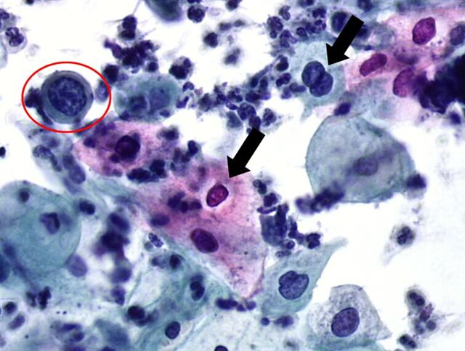
Diagnosis
Cytology
Histology

Slide 6
CLINICAL STAGING AND THERAPY
CURE
IMPROVEMENT
CIS:
Conization,
LOOP,
Partial cervicotomy
Curable
ICC-- 1A:
Diagnostic intervention
Surgery
Surgery + Local Radiation
All are curable
ICC--1B & up:
Local surgery
Radical surgery,
Radiation,
Chemotherapy
Combination therapy
Alternative therapy
None is curable

Slide 7
Cervical cancer is preventable
The disease is preventable and curable IF detected on time.
Women in developed countries are well protected with regular screening and early removal of suspect lesions.
Cytological screening (Pap test) remains the best cervical cancer prevention.

Slide 8


EPIDEMIOLOGY
US [STANDARD]: 350 million
Women at risk: 110 million
Screening outreach: >80%
WORLD: 7.3 BN
Women at risk: 2.5 bn
Screening outreach: < 20%
Egypt: 84 million
Women at risk: 28 million
Screening outreach: ? Diagnosis???
CC (2012) prevalence: 12,000; mortality: 4,000
CC(2012) prevalence: 600,000; mortality: 360,000
CC (2010) prevalence: 514; mortality: 299
Per 10e6
P: 11; M:4
Per 10e6
P: 2.4; 1.44
Per 10e6
P:1.7; 1.06

Slide 9
COMPARISON USA VS. EGYPT
USA
EGYPT
> 1950: PAP TEST launched with 80% disease reduction
PRESENT: PAP TEST + ADDITIONALS (LBP, HPV, DNA)
2012 >: IMPROVED PAP
THERAPY: STILL OBSOLETE
PRE PAP SITUATION
DISEASE NOT RECOGNIZED AS SERIOUS PENDING PROBLEM
NEEDS:
BETTER DIAGNOSIS
BETTER PREVENTION OF RISK FACTORS AND CANCER CONTROL – SCREENING

Slide 10
US Example
Before Pap test in the first half of the 20th Century, US had almost no organized cervical cancer control (screening) and the rates for cervical cancer prevalence and mortality were increasing steadily. In the middle of that Century the American Cancer Society promoted a cytological screening developed by Dr. Papanicolaou ( Pap test). The outreach from about less than 5% was raised to 80% and the prevalence and mortality was decreased for 80%. There are about 50 mil Pap test done each year in this country, and cervical cancer prevalence and mortality decreased below the red line of 10 most frequent diseases in the US.

Slide 11
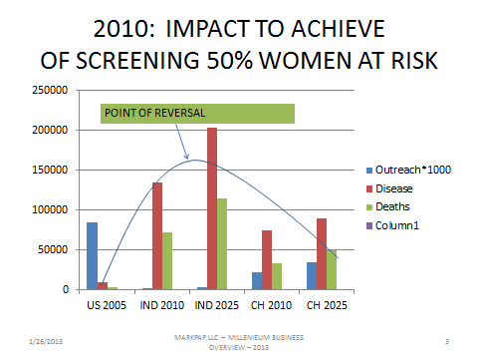
OUTREACH & DISEASE
STRATEGY TO REVERSE CC TRENDS

Slide 12
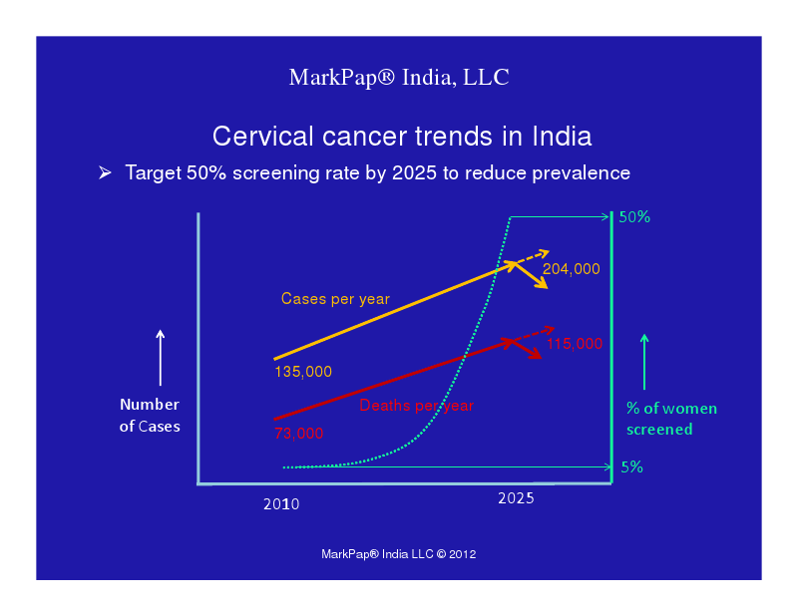

Slide 13
EGYPT NEEDS STRATEGY FOR FIGHT AGAINST CERVICAL CANCER
IMPROVE AWARENESS
PROFERSSIONAL EDUCATION
SCHOOL EDUCATION
PREVENT DEVELOPMENT
REDUCING RISKS
SCREENING FOR EALY LESIONS AND REMOVAL

Slide 14
TOOLS TO ENABLE NEW STRATEGY
SELF-COLLECTING KIT
TELEMEDICNE
TEST PROCESSING KIT
COLLECTION TOOL - OTC
eConnection POC-Expert center
Biomarker visualization and image capturing

Slide 15
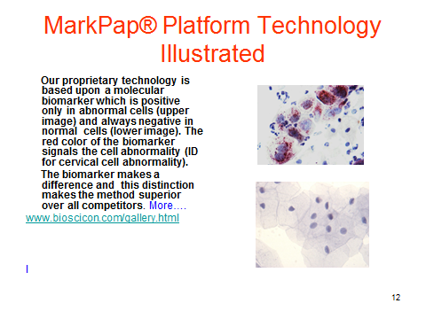
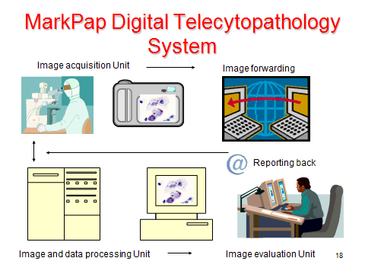
DIAGNOSIS
CYTOLOGY
TELEMEDICINE

Slide 16
EXPECTED RESULTS:
FUTURE OF CC IN EGYPT
AWARENES
INCREASE AMONG PROFESSIONALS, POLICY MAKERS, INSUARANCE, AND PUBLIC
SCREENING
INCRESE TO 50% OF WOMEN AT RISK WITHION 10-15 YEARS OF IMPLEMENTATION
HEALTH STATISTICS
UPADATE
DISEASE TRENDS
REVERSE FROM INCRESSING THE MORTALITY AND PREVLALENCE TO DECRESING TREND

Slide 17
FUTURE
New improvement are needed to make Pat test –like screening affordable, accessible, infrastructure independent and equitable for developing countries
On the International Congress of Cytology that will be held on the May 28, 2013 in Paris, there will be lot of discussion on this subject
Our presentation: Evaluation of cytology screening strategies for cervical cancer in resource poor settings. Iyer VK, Mathur SR, Bhatla N, Markovic O.

Slide 18
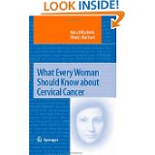
FURTHER READINGS
First Edition, Springer, 2008
Second Edition, Springer, 2010
Updated and extended Edition, Springer, 2014
www.amazon.com
www.markpap.com
www.bioscicon.com
No effort is too big, nor investment too large to save one human life.

Slide 19
CONTACT
FOR ADDITIONAL INFORMATION PLEASE CONTACT:
GLOBAL ACADEMY FOR WOMEN’S HEALTH
9601 MEDICAL CENTER DRIVE, RM 111
JOHNS HOPKINS UNVERSITY, MCC
PROF. DR. OLIVERA MARKOVIC
P/F: 1.301.610.9130
Web-site: www.markpap.com

